Slide 1

CS 470 Project Two Conference Presentation: Cloud Development
Thomas Martin
December 2024

Slide 2

Migration Journey to AWS Microservices
Thomas Martin
Southern New Hampshire University
Computer Science
Objective: Bridge the gap between technical and nontechnical perspectives on cloud migration.
Focus: Transition from a traditional full-stack web application to a cloud-native solution.
Explore essential migration steps and critical design decisions.
Highlight the advantages of AWS’s robust and scalable ecosystem.
Notes:
Talking Points for PowerPoint Presentation
Opening Statement:
"Welcome to this presentation on the migration journey from a traditional full-stack web application to a cloud-native solution powered by AWS microservices."
Purpose of the Presentation:
"This session is designed to bridge the gap between technical and nontechnical perspectives, ensuring the intricacies of cloud development are clear and accessible to all."
Topics to Explore:
Essential Steps in the Migration Process:
Containerization
Containerization Platform
cloud-native services
Orchestration
The Serverless Cloud
Amazon S3
API & Lambda
Database
Transition Statement:
"Together, we’ll walk through the transformation process, exploring how modern cloud technologies enable scalability, efficiency, and resilience in web applications."

Slide 3
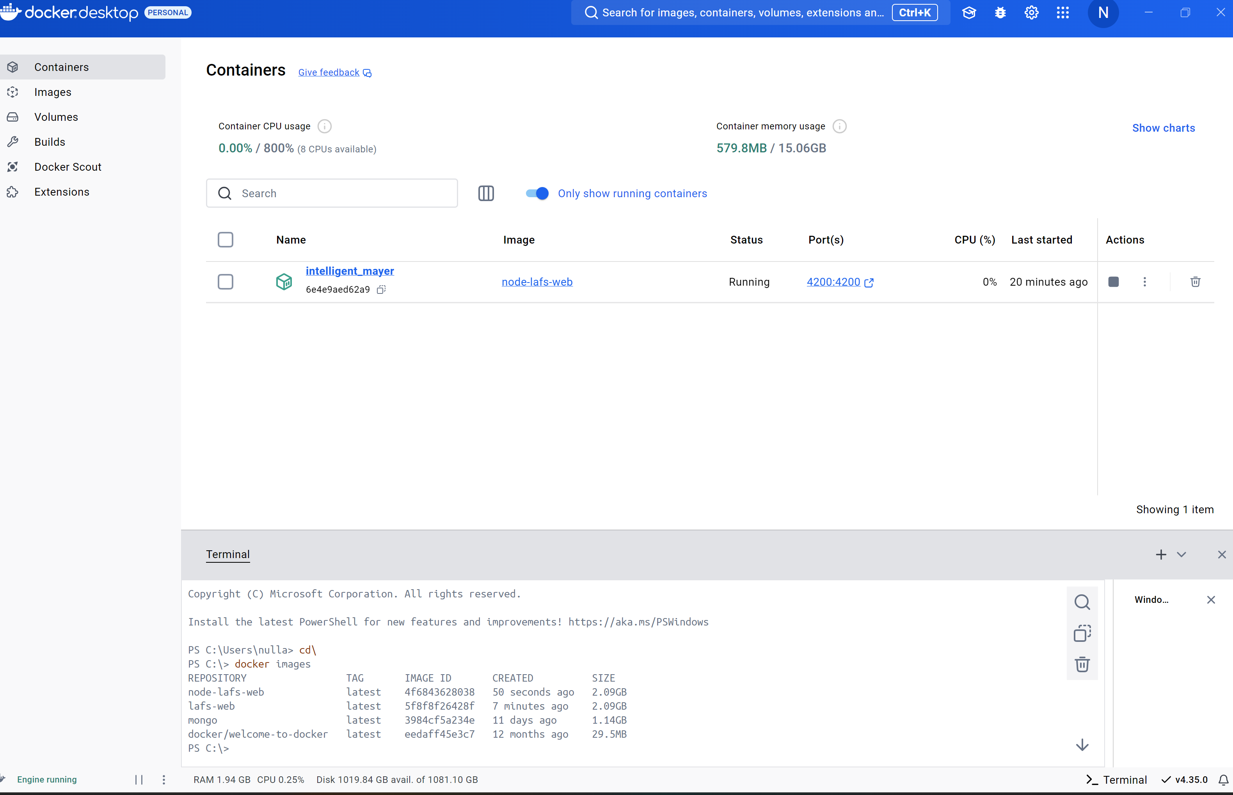
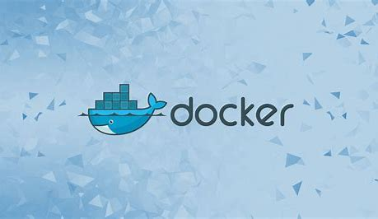
Containerization
Migrating a full stack application to the cloud.
What we need for containerization?
Migration Models
This project utilized Replatforming
Docker
Docker Compose
Notes:
Talking Points for Containerization and Cloud Migration
1. Introduction to Containerization
What is Containerization?
"Containerization involves packaging an application and its dependencies into a lightweight, portable container that can run consistently across different environments."
Containers ensure that the application works reliably regardless of the underlying infrastructure.
2. Migrating a Full-Stack Application to the Cloud
Key Considerations:
Selecting the right migration model is crucial for aligning with application requirements and leveraging cloud infrastructure benefits.
Migration models differ based on the level of changes made to the application.
Four Common Cloud Migration Models:
Rehosting:
"Moving the application 'as-is' to the cloud without modifying its architecture."
Best for legacy applications or quick migrations.
Replatforming:
"Making minor changes to optimize the application for the cloud."
Balances ease of migration with performance gains.
Refactoring:
"Rebuilding significant portions of the application to make it cloud-native."
Involves restructuring for scalability and flexibility.
Rebuilding:
"Completely redesigning the application for the cloud from scratch."
Offers maximum benefits but requires significant effort.
Our Approach for This Project
Migration Model: Replatforming
"For this project, we will be using the replatforming model, making minor changes to optimize the application for the cloud."
Focused on balancing migration speed and leveraging cloud capabilities.
Containerization Platform: Docker
Why Docker?
"Docker is the most popular containerization platform, used for creating, managing, and running containers."
Offers:
Portability across environments.
Resource efficiency and fast deployment.
Extensive community support and integrations.
Cloud-Native Services and Monitoring Tools
Using Docker Compose for Multi-Container Applications:
"Docker Compose allows us to define and manage multi-container Docker applications with a single configuration file."
Benefits include:
Simplified deployment for applications with multiple services (e.g., frontend, backend, database).
Centralized management of container configurations for efficiency.
Importance of These Tools
"These tools are essential for streamlining the migration process, ensuring that the application performs effectively in the cloud environment."
Docker and Docker Compose:
Enhance development speed and reliability.
Simplify cloud integration and monitoring.
Transition to Next Section
"With these tools and strategies in place, we are well-equipped to ensure a smooth migration process, maximizing the benefits of cloud infrastructure for our application."

Slide 4
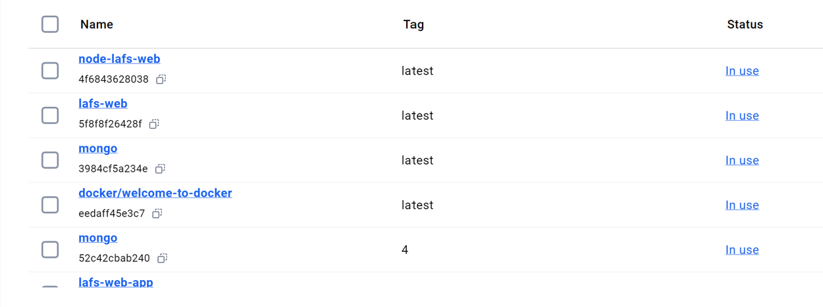
Orchestration
Manage containerized applications at scale, handling deployment, scaling, and monitoring
Deploying and starting containers
Scaling applications
High availability and fault tolerance
Managing networking
Updating applications
Monitoring container performance.
Notes:
.
Talking Points for Orchestration
1. Introduction to Orchestration
"Orchestration refers to the automated arrangement, coordination, and management of containers in complex applications."
It ensures that containerized applications run efficiently and are easily manageable as they scale in size and complexity.
2. Why Orchestration is Essential
Containers provide portability but managing them manually becomes challenging as applications grow.
Orchestration simplifies the management of multi-container environments, ensuring consistency and reliability.
Key Tasks Automated by Orchestration
Deploying and Starting Containers:
"Orchestration automates the deployment and initialization of containers, ensuring all services are up and running seamlessly."
Scaling Applications:
"It adjusts the number of containers automatically to meet changes in demand, scaling up during peak times and scaling down when demand decreases."
Ensuring High Availability and Fault Tolerance:
"Orchestration ensures applications remain available by restarting failed containers or redistributing workloads."
Managing Networking Between Containers:
"It handles communication between containers, linking services securely and efficiently."
Updating Applications with Minimal Downtime:
"Orchestration supports rolling updates, ensuring that new versions of applications are deployed without disrupting service."
Monitoring and Logging:
"It tracks container performance, providing metrics and logs for troubleshooting and optimization."
4. Benefits of Orchestration
Reduces manual intervention, improving developer productivity.
Enhances system reliability and uptime through automated fault recovery.
Simplifies complex deployments, making applications more scalable and resilient.
5. Transition to Tools
"With orchestration at the core of container management, tools like AWS ECS provide powerful platforms to automate these tasks effectively, making cloud-native application management simpler and more robust."

Slide 5
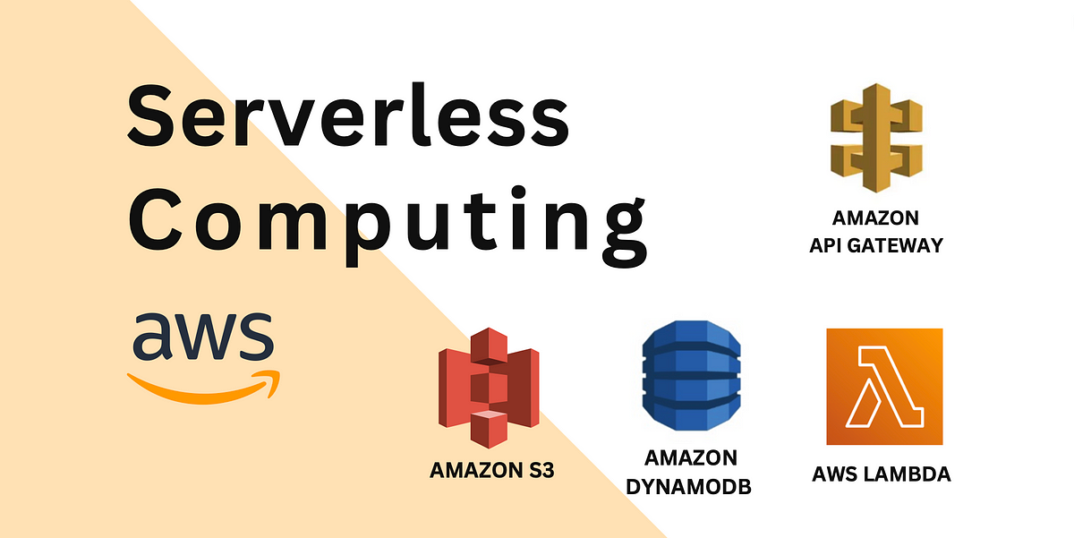
The Serverless Cloud
Amazon S3
(Simple Storage Service)
Scalability
Cost Efficiency
Durability
Rapid Deployment
Global Availability
Compared to Local Storage
S3 offers unmatched scalability, durability, and global accessibility, making it ideal for distributed applications and massive datasets. Local storage, on the other hand, is better for low-latency, offline, or secure local operations.
Notes:
Talking Points for Serverless Computing and Amazon S3
1. Introduction to Serverless Computing
"Serverless is a cloud computing execution model where the cloud provider dynamically manages the allocation and provisioning of servers."
Removes the need for server management, allowing developers to focus entirely on writing code and building applications.
2. Benefits of Serverless Computing
Scalability:
"Serverless applications automatically scale based on demand, efficiently handling variable workloads."
No need for manual intervention to adjust capacity.
Cost Efficiency:
"With a pay-as-you-go model, users only pay for the compute resources consumed during execution, avoiding idle server costs.“
Rapid Deployment:
"Serverless platforms provide streamlined deployment pipelines, accelerating the development lifecycle."
Developers can deploy code in minutes without configuring servers.
Global Availability:
"AWS replicates serverless functions across regions, ensuring low-latency and high-availability services worldwide.“
3. Amazon S3 Overview
"Amazon S3 (Simple Storage Service) is an object storage service provided by AWS, designed to store and retrieve any amount of data, anytime, from anywhere on the web."
Features include:
Scalability: Handles vast amounts of data seamlessly.
Durability: Designed for 99.999999999% (11 9's) durability by replicating data across multiple servers and facilities.
Security: Provides advanced security features, including encryption and fine-grained access controls.
4. Comparing S3 with Local Storage
Advantages of S3:
"S3 offers unmatched scalability, durability, and global accessibility, making it ideal for distributed applications and massive datasets."
Supports high-availability use cases like backups, media storage, and content delivery.
Advantages of Local Storage:
"Local storage is better suited for low-latency, offline operations, or secure, localized data handling."
Useful for applications requiring fast access without relying on an internet connection.
5. Use Cases for S3 in Cloud Applications
Content delivery for websites or mobile apps.
Storage of large-scale backups or disaster recovery data.
Hosting media files, logs, or other unstructured data for analytics.
6. Transition Statement
"By combining serverless computing with services like Amazon S3, modern cloud applications achieve unprecedented levels of scalability, cost efficiency, and global reach, transforming the way we build and deploy software solutions."

Slide 6
The Serverless Cloud
API & Lambda
Serverless APIs built using cloud providers like AWS Lambda offer several advantages:
Scalability
Cost Efficiency
Reduced Operational Overhead
Global Reach
Lambda API Logic
AWS Lambda is a popular choice for
implementing serverless APIs.
Integrating the Frontend and Backend
Notes:
Talking Points: Advantages of Using a Serverless API
1. Introduction to Serverless APIs
"Serverless APIs, powered by cloud services like AWS Lambda, offer an efficient and modern approach to building and scaling applications."
Eliminates the need for traditional server management, allowing developers to focus solely on application logic.
2. Key Advantages of Serverless APIs
Scalability:
"Serverless APIs automatically adjust to traffic demands, effortlessly handling spikes without any manual intervention."
Perfect for unpredictable workloads or rapidly growing user bases.
Cost Efficiency:
"With a pay-as-you-go model, you only pay for the compute resources consumed during execution, avoiding costs for idle servers."
Cost-effective for startups and enterprises alike.
Reduced Operational Overhead:
"No need to manage, patch, or configure servers—the cloud provider handles the underlying infrastructure."
Frees up development resources for innovation and faster delivery.
Global Reach:
"Easily deploy APIs across multiple regions, ensuring low latency and a better user experience for customers worldwide.“
3. Lambda API Logic
"AWS Lambda is a widely adopted choice for building serverless APIs because of its seamless integration with other AWS services and ability to execute backend logic efficiently."
Automatically scales based on demand and supports event-driven workflows.
Why Choose Lambda?
Integrates with AWS services like DynamoDB, S3, and API Gateway.
Executes code in response to events such as HTTP requests or database updates.
Reduces operational overhead and speeds up development cycles.
4. Integrating Frontend with Backend
For this project, the integration process includes:
Developing Backend Logic:
"We used frameworks like Node.js to create efficient backend services."
Creating RESTful API Endpoints:
"These endpoints handle data flow between the frontend and backend, enabling structured communication."
Enabling Cross-Origin Resource Sharing (CORS):
"CORS ensures secure data exchange between the frontend and backend, especially when hosted on different domains."
Building the Frontend:
"Frameworks like Angular were used to develop a responsive UI, connected to the API for seamless data exchange."
5. Transition to Cloud-Native Benefits
"By leveraging serverless APIs and modern frameworks, we’ve created a scalable, cost-efficient, and globally accessible solution that simplifies the development process while enhancing user experiences."

Slide 7
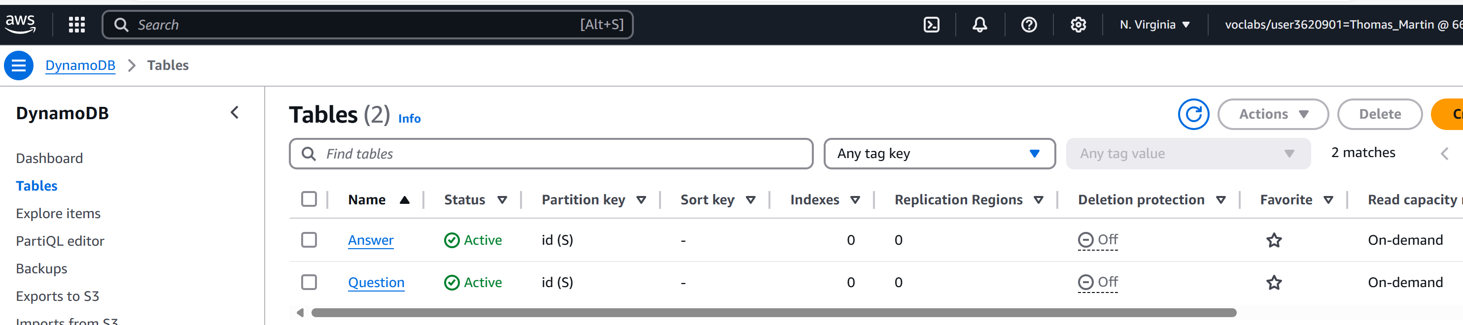
The Serverless Cloud
Database DynamoDB
MongoDB and DynamoDB
Data Structure
Scalability
Query Language
Scripts
Notes:
Talking Points: Amazon DynamoDB Overview
1. Introduction to Amazon DynamoDB
"Amazon DynamoDB is a fully managed NoSQL database service provided by AWS."
Designed for applications requiring low-latency, high-throughput performance, and scalability.
Ideal for managing key-value and document-based data with the flexibility to adapt to diverse use cases.
2. Key Features of DynamoDB
Serverless Architecture:
"DynamoDB eliminates the need to manage servers or infrastructure, allowing developers to focus on application logic."
Fully managed by AWS, reducing operational overhead.
On-demand Scaling:
"DynamoDB automatically scales to handle traffic spikes and adjusts capacity as needed."
Offers two modes:
Provisioned Capacity: Ideal for predictable workloads.
On-demand Capacity: Suitable for unpredictable traffic patterns.
Data Model:
Key-Value Pairs:
"Efficient for simple lookups and straightforward data retrieval."
Document Storage:
"Supports flexible, JSON-like documents for unstructured or semi-structured data."
3. Queries Used in This Project
"For this project, we utilized standard CRUD operations via HTTP methods to interact with DynamoDB."
Operations Include:
GET: Retrieve items from the database.
POST: Add new items to the database.
PUT: Update existing items.
DELETE: Remove items from the database.
These methods ensure seamless and efficient interaction between the application and the database.
4. Scripting with JavaScript
"We used JavaScript scripts to connect the frontend to DynamoDB, leveraging the AWS SDK for JavaScript to perform CRUD operations."
Capabilities of the Scripts:
Querying data for retrieval.
Inserting new data entries.
Updating existing data records.
Deleting unnecessary or obsolete data.
Example: The AWS SDK simplifies integration and automates interactions with the database.
5. Why DynamoDB for This Project
Scalability and performance tailored to the needs of cloud-native applications.
Serverless architecture eliminates infrastructure management, allowing faster development cycles.
Flexibility to handle both structured and unstructured data efficiently.
6. Transition Statement
"By leveraging DynamoDB, we created a robust and efficient backend capable of handling real-time data demands with minimal operational overhead."

Slide 8
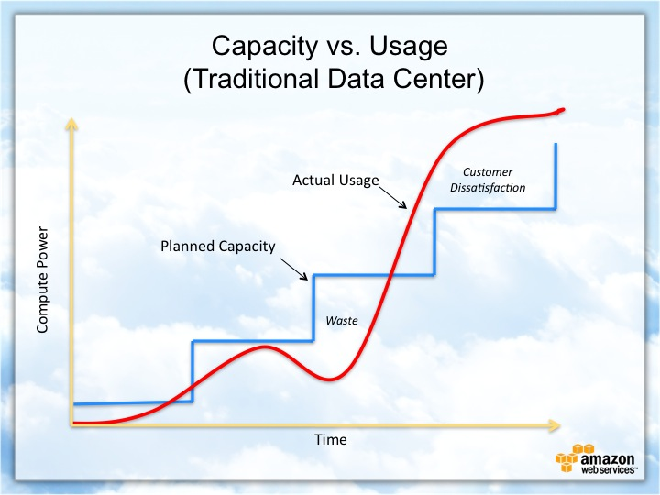
Cloud-Based Development Principles
Elasticity
Pay-for-use model
Notes:
Talking Points: Cloud-Based Development Principles
1. Introduction to Cloud-Based Development Principles
"Cloud-based development leverages the unique advantages of cloud infrastructure to build scalable, cost-efficient, and agile applications."
Two key principles that drive cloud efficiency are Elasticity and the Pay-for-Use Model.
2. Elasticity
Definition:
"Elasticity refers to the ability of a cloud-based system to automatically scale resources up or down based on demand."
Key Benefits:
Demand-Driven Scaling:
Resources automatically expand during traffic spikes and shrink during low usage periods.
"This ensures optimal performance without over-provisioning resources."
Cost Optimization:
"With elasticity, organizations pay only for the resources they actually use, reducing waste."
Enhanced User Experience:
"Applications remain highly responsive, even under variable workloads, ensuring consistent performance.“
3. Pay-for-Use Model
Definition:
"The pay-for-use model ensures users are charged only for the compute, storage, or network resources they consume."
Key Benefits:
Cost Efficiency:
"No upfront costs for unused resources, allowing businesses to align expenses with actual usage."
Flexibility:
"Businesses can scale their operations without committing to fixed infrastructure investments."
Accessibility for All Sizes:
"Startups and enterprises alike can leverage cloud resources without large capital expenditures."
Example in Practice:
"A startup using AWS Lambda only pays for the execution time of its functions, avoiding the costs of idle servers.“
4. Why These Principles Matter
"Elasticity and the pay-for-use model enable businesses to respond quickly to market demands, reduce operational costs, and ensure high availability, making cloud-based development a cornerstone of modern applications."
5. Transition Statement
"By adhering to these cloud-based development principles, we can create applications that are not only efficient and scalable but also cost-effective and highly adaptive to user needs."

Slide 9
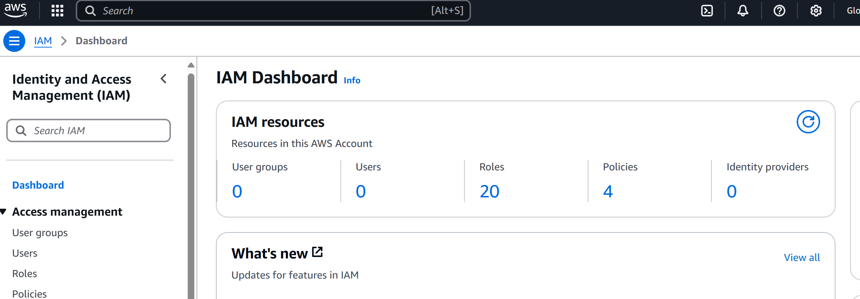
Security in the Cloud
Access
Policies
API Security
How can you prevent unauthorized access?
Explain the relationship between roles and policies.
What custom policies were created?
How can you secure the connection between Lambda and Gateway?
Lambda and the database
S3 Bucket
Notes:
Talking Points: Securing Your Cloud Application
1. How Can You Prevent Unauthorized Access?
Identity and Access Management (IAM):
Use IAM to control access to AWS resources.
Implement least privilege access to limit permissions to only what is necessary.
Resource Policies:
Apply policies on resources like S3 buckets and API Gateway endpoints to restrict access.
2. Explain the Relationship Between Roles and Policies
Roles:
"Roles provide temporary credentials for AWS services to perform specific tasks without hard-coded credentials."
Example: A Lambda function uses a role to access a DynamoDB table.
Policies:
"Policies define permissions in JSON format, specifying allowed or denied actions on AWS resources."
Relationship:
Roles assume the permissions defined in policies.
Policies can be attached to roles, users, or groups, ensuring consistent and secure access control.
3. What Custom Policies Were Created?
Custom Policies Implemented in the Project:
Lambda to S3 Access Policy:
Allows Lambda functions to read and write to specific S3 buckets.
API Gateway Resource Policy:
Restricts API access to specific IP ranges or authenticated users via IAM.
Database Access Policy:
Grants Lambda read and write permissions for a specific DynamoDB table, limiting access to required operations only.
4. Securing the Connection Between Lambda and API Gateway
Implement resource policies on API Gateway to restrict access to trusted sources.
5. Securing the Connection Between Lambda and the Database
Best Practices:
Grant Lambda access to the database with a specific IAM role and a custom policy.
6. Securing the S3 Bucket
Key Security Measures for S3:
Bucket Policies:
Restrict access to specific IAM roles, users, or trusted IP addresses.
S3 Block Public Access:
Prevent accidental public exposure of data by enabling block public access settings.
Versioning:
Enable versioning to safeguard against accidental overwrites or deletions.
Access Logging:
Enable S3 logging to monitor and audit access to the bucket.
7. Transition Statement
"By implementing these security best practices, we can ensure a robust and secure cloud application, safeguarding data integrity, confidentiality, and availability while adhering to AWS’s shared responsibility model."

Slide 10
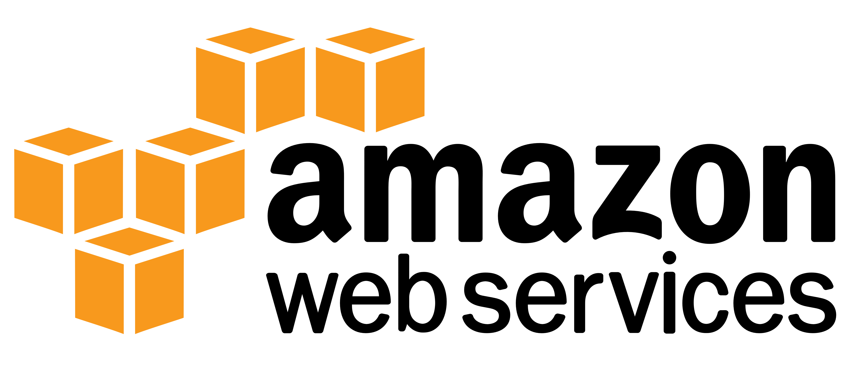
Conclusion
Three Main Points About Cloud Development
No Server Management
Serverless development eliminates the need to provision, manage, or maintain servers.
Elasticity and Scalability
Cloud development enables applications to automatically adjust resources based on demand.
Cost-Efficiency Through the Pay-for-Use Model
Cloud platforms operate on a pay-as-you-go model, where users only pay for the resources they consume.
Notes:
Talking Points: Three Main Points About Cloud Development
1. No Server Management
"One of the core advantages of cloud development, especially with serverless models, is the elimination of server management."
Developers no longer need to provision, patch, or maintain physical or virtual servers.
Cloud providers, like AWS, handle all infrastructure-related tasks, allowing teams to focus on writing and deploying code.
2. Elasticity and Scalability
"Cloud development ensures applications can adapt seamlessly to varying workloads."
Elasticity:
Automatically scales resources up during high demand and scales down during low usage periods.
Ensures optimal resource utilization and performance.
Scalability:
Cloud services can scale to accommodate millions of users or scale back to minimal resources for small workloads.
3. Cost-Efficiency Through the Pay-for-Use Model
"The pay-as-you-go model is a hallmark of cloud development, offering significant cost advantages."
Users pay only for the compute, storage, or network resources they consume, avoiding costs for idle infrastructure.

